Slide 1

Crop Planning System
By…Peerapat Kaewjinda
Adviser…Assoc.Prof.Dr.Rapepun Piriyakul
Co-adviser…Assoc.Prof.Dr.Montree Piriyakul

Slide 2
Agenda
Problem
Objectives
Propose Framework
Methodology
Data Sources
Techniques
Tools
Overall result
Conclusion and Recommendation

Slide 3
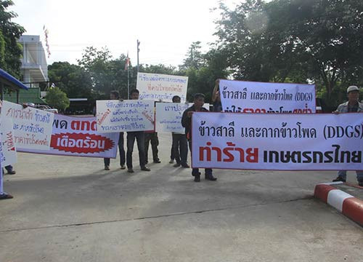


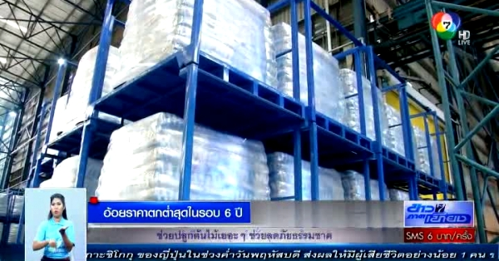
Problem

Slide 4













Problem

Slide 5



Solution
We would recommend that you should plant crops.
Statistic +

Slide 6
Objectives
Develop decision support system model for manage agricultural crops.
Create an agricultural crops information system for government executives to export agricultural products.

Slide 7
Propose Framework
Suggestion for rice, corn, cane, cassava.
Data analysis consists of demand, water’s quantity, suitability of crop each area.
Techniques used in agricultural price forecasting are Artificial Neural Network and ARIMA.
AHP techniques are used to weight.

Slide 8
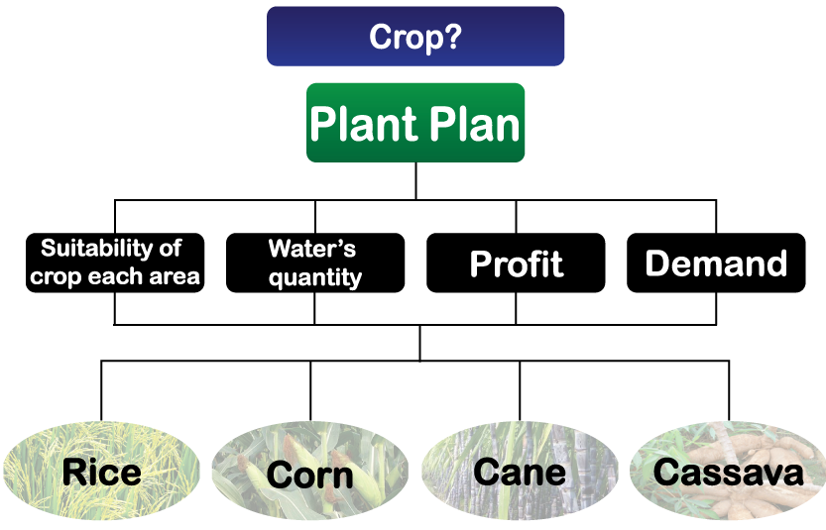
Methodology

Slide 9
Why
Factor |  | Reason
1. Rainfall | r | We can't control rainfall and don't know how many can we get.
2. Price in the past | a | We use price in the past for forecasting price in the future.
3. Temperature | r | We can't control temperature and the average temperature in Thailand is quite similar.
4. Current price | a | We use current price for forecasting price in the future.

Slide 10
Why
Factor |  | Reason
5. Knowledge | r | Everyone can learn new thing and develop potential.
6. Water usage | a | We calculate and compare between water usage of the crop and remain water in the near irrigation.
7. Demand or derivatives | a | The factor that affects the sale of the crop.
8. Suitability of crop each area | a | The factor that affects the product.

Slide 11
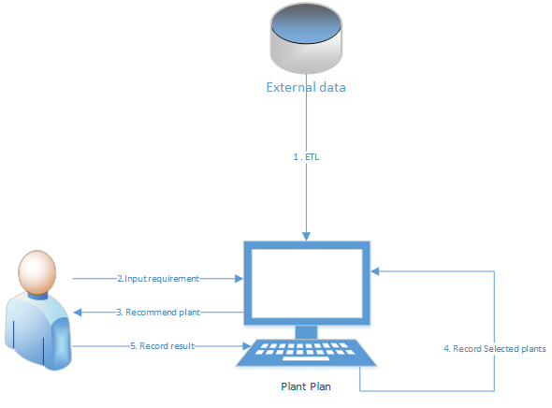
How

Slide 12



Data Sources
NECTEC
Suitable areas
Water Watch and Monitoring System for Warning Center
Water in irrigation
Office of Agricultural Economics
Price of each crops
Cost of each crops
Water usage of each crops
Demand of each crops

Slide 13
Techniques
Data Transformation
RDBMS
EBCDIC
Flat files
XML
Spread sheets
Legacy
Internal
Data
Dimension table Build
Fact table Build
ETL
Stringing Area
Working storage
Reject data storage
Data Mart
Transfer
Load
External Data
Reject
Exception
Data Cleansing

Slide 14
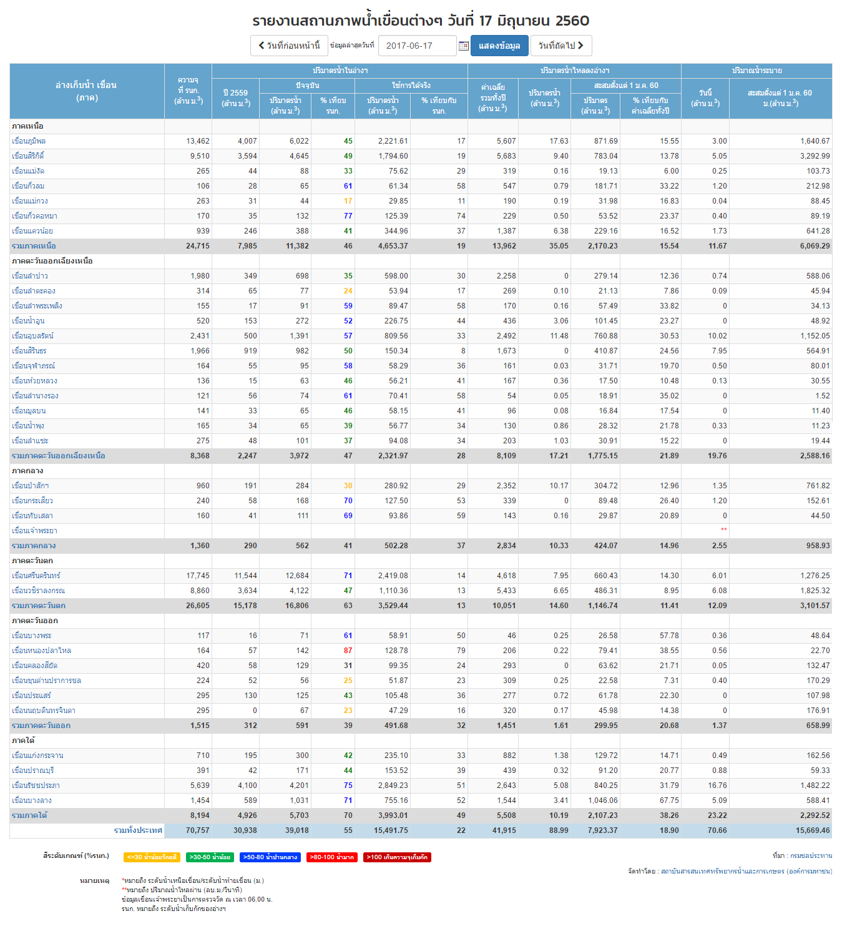
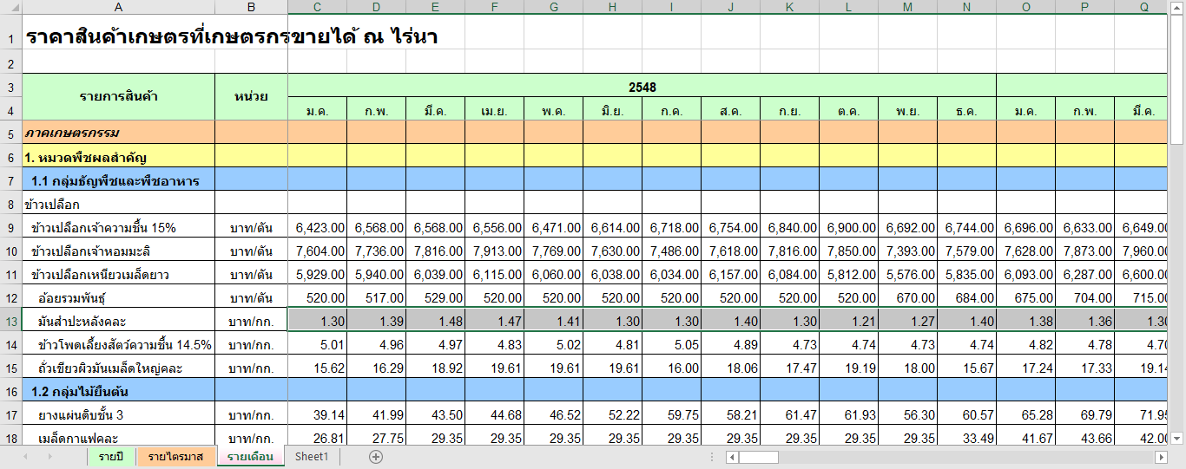
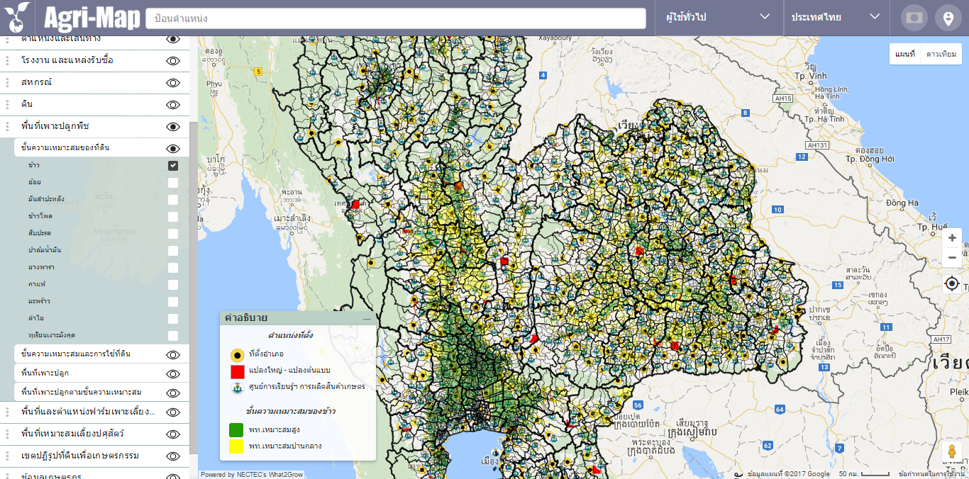
Example Data

Slide 15


Techniques
Forecasting
Artificial Neural Network
ARIMA (Autoregressive Integrated Moving Average Model)

Slide 16
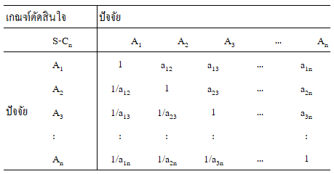
Techniques
AHP

Slide 17






Tools

Slide 18
Expected Advantage
To manage the cultivating agricultural crops for both farmers and exporters.
2. Have a database of agricultural crops available in real time (Online Real Time)

Slide 19
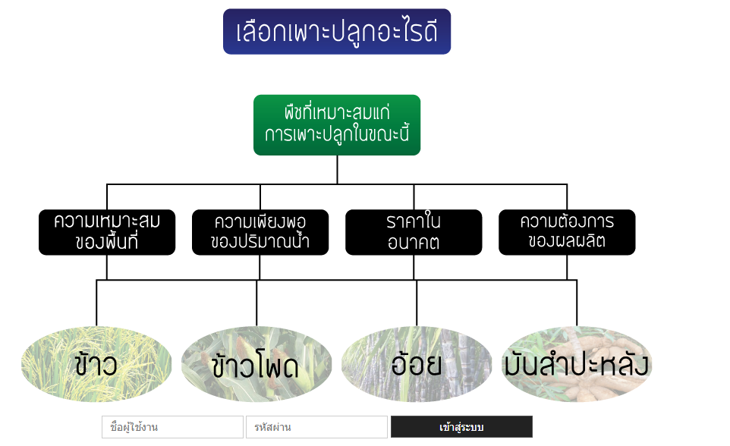
Overall result

Slide 20
Price forecast of agricultural
ANN
Learning Rate
Momentum
Hidden Layer
Training Time
Lag
Data
150 Monthly price
139 Monthly export price
ARIMA
P
d
q

Slide 21
Price forecast of agricultural
ANN
 | Learning Rate | Momentum | Hidden Layer | Training Time | Lag | MSE | MAPE
Rice | 0.3 | 0.3 | 5 | 5000 | 6/12 | 306,929.61 | 5.10
Rice (Multivariable) | 0.5 | 0.3 | 3 | 500 | 12/12 | 342,442.29 | 5.31
Corn | 0.1 | 0 | 1 | 50 | 6/6 | 477,702.72 | 9.98
Cane | 0.2 | 0 | 6 | 500 | 1/6 | 6,712.06 | 9.23
Cassava | 0.3 | 0.3 | 3 | 500 | 1/1 | 66,015.47 | 11.91

Slide 22
Price forecast of agricultural
ARIMA
 | p | d | q | MSE | MAPE
Rice | 1 | 2 | 0 | 279,385.55 | 5.02
Rice (Multivariable) | 2 | 2 | 0 | 304,697.18 | 5.20
Corn | 2 | 2 | 0 | 296,615.81 | 6.75
Cane | 2 | 2 | 0 | 5,225.25 | 7.30
Cassava | 6 | 2 | 1 | 68,649.25 | 13.77

Slide 23
Price forecast of agricultural
 | ARIMA |  | ANN
 | MSE | MAPE | MSE | MAPE
Rice | 279,385.55 | 5.02 | 306,929.61 | 5.10
Corn | 296,615.81 | 6.75 | 477,702.72 | 9.98
Cane | 5,225.25 | 7.30 | 6,712.06 | 9.23
Cassava | 68,649.25 | 13.77 | 66,015.47 | 11.91

Slide 24
Conclusion
Present information for crop
Recommended plant for best profit
Overall information of crop for government, exporter and interrelated
Can prepare and prevent for less or over crop

Slide 25
Recommendation
More choice of plant
Recommended ratio of crop in the area
Use multi variable for every plant or find another impact parameter

Slide 26

Thank you
Plant Plan

Slide 27
Reference
กฤษญกร พงษ์พรรฦก. (2553). ระบบสนับสนุนการตัดสินใจในการคัดเลือกพื้นที่สร้างศูนย์กระจายสินค้า กรณีศึกษาบริษัท ซูกิชิ อินเตอร์กรุ๊ป จำกัด. การศึกษาอิสระ วท.ม. (ระบบสนับสนุนการตัดสินใจ). กรุงเทพฯ: บัณฑิตวิทยาลัย มหาวิทยาลัยรามคำแหง.
พงษ์ศิริ ศิริพานิช. (2551). การพยากรณ์อนุกรมเวลาด้วยตัวแบบผสมระหว่าง ARIMA และ เครือข่ายประสาทเทียม. สารนิพนธ์ วท.ม. (คณิตศาสตร์และเทคโนโลยีสารสนเทศ). กรุงเทพฯ: บัณฑิตวิทยาลัย มหาวิทยาลัยศิลปากร.
สำนักอุทกวิทยาและบริหารน้ำ. (2554). คู่มือการหาปริมาณการใช้น้ำของพืช ปริมาณการใช้น้ำของพืชอ้างอิง และค่าสัมประสิทธิ์พืช. กรมชลประทาน.
อาทิตย์ ศรีแก้ว. (2552). ปัญญาเชิงคำนวณ (พิมพ์ครั้งที่ 1). เอกสารประกอบการสอน สาขาวิชาวิศวกรรมไฟฟ้า มหาวิทยาลัยเทคโนโลยีสุรนารี.
Aakash G Ratkal, Gangadhar Akalwadi, Vinay N Patil and Kavi Mahesh. (2559). Farmer’s Analytical Assistant. PESIT, PES University, Bangalore, India.
Artificial Neural Network (ANN). (2560). [Online]. Available: https://th.wikipedia.org/wiki/โครงข่ายประสาทเทียม
CartoDB. (2560). [Online]. Available: https://en.wikipedia.org/wiki/CartoDB
ETL (Extract, Transform and Load). (2551). [Online]. Available:
http://kanompia.blogspot.com/2010/08/data-integration-with-etl.html
Santosh Kumar K, Suresh Babu DB. (2559). A Web GIS Based Decision Support System for Agriculture Crop Monitoring System-A Case Study from Part of Medak District. Hyderabad, Telangana, India.
N. Hemageetha, G. M. Nasira. (2556). Radial Basis Function Model for Vegetable Price Prediction. India.
W. Pannakkong1, J. Buddhakulsomsiri1, P. Parthanadee. (2556). Simulation Modeling Analysis to Support Decision Making of Cassava Harvesting in Thailand. Sirindhorn International Institute of Technology, Thammasat University, Pathum Thani, Thailand.

